Slide 1
Welcome! Thanks for coming!
Kindergarten Back-to-School Night
2016-2017
-Take a moment to jot down our class blog address
http://manningsmarvelousmonsters.weebly.com

Slide 2
A few attendance reminders…
Doors to the school open at 7:10. At this time, students will either go to breakfast if needed or they will wait in the hallway outside of their classroom with the teacher on duty.
Students need to be in their classrooms by 7:40. Students that arrive after 7:40 will be counted tardy. Tardies are recorded along with absences.
Students are counted absent if they arrive after 9:00.
Parents are not permitted in academic hallways unless they have checked in with the office and gotten a name tag.

Slide 3
Dismissal
If your child is a bus rider, please work on having them memorize their bus
number. We are doing the nametags for the first few days, but soon they will
HAVE to know that information.
-If your child is a car rider, they will go out on the East side of the building. This is only the “valet” side, as it is not for parents that are parking and walking up.
-If you plan to walk up and get your student, they are considered a “walker” and will be on the West side of the school for dismissal time.

Slide 4
Food & Drink
Our lunch time is 11:54-12:24
If you are planning to join us for lunch (after the 3rd week) please meet us in the cafeteria.
Make sure that if your student brought lunch from home that it is in a container they can open. There are cafeteria monitors that help with us, but it is great to be independent!
Snack & Water Bottle (please send daily)
Water Bottles (filled & with student name on it)
Snack- in a separate bag (not in lunch box)
We will do a morning snack so please be mindful of that.

Slide 5
Many kindergartners come into kindergarten already reading!
Each child will be assessed thoroughly and taught at their own level. Being able to read text is a WONDERFUL thing, but it is not the only thing we focus on. Students will develop comprehension skills during this important year!
We will do reading assessments throughout the year to help identify student reading levels. Remember, that while just fluently reading words is part of it…the assessments and grouping is based on students’ understanding of what they have read.

Slide 6
Assessments & Report Cards
Reading levels are not determined by decoding skills alone. Children must be able to:
Read with fluency and intonation.
Determine a purpose for reading.
Read and enjoy a wide variety of genres.
Independently retell the beginning, middle and end of a story, including details.
Summarize a story.
Answer questions about a story that include higher-level thinking skills.
Make personal connections and connections between texts.
Make predictions, inferences and draw conclusions.
Report cards come home at the end of the grading period/nine weeks.
Please know that this is a reflection of what your student is doing in class and may not look
the same as a friend, neighbor’s, etc. Each child is different. Scores range from 1-4. Our end of year goal is to have at least a 3 for “mastery”.
Do not be surprised to see a “1” marked the
first grading period. This is perfectly appropriate for the beginning of Kindergarten.

Slide 7
EOY Reading Expectations
Student recognizes at least 25 sight words in a variety of contexts.
Students use basic decoding skills to read unknown words.
Students can blend and segment 3 and 4 letter words.
Students can recognize and produce rhyming words.
Students can recognize all 26 letters in both uppercase and lowercase and in a variety of fonts and texts.
Students can produce and recognize all 41 phonemes (letter sounds).
Students need to comprehend text read to them and text they read independently.

Slide 8
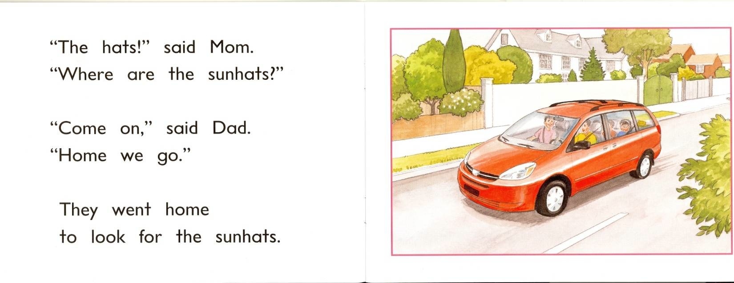
Your child should be independently reading at a level C by the end of kindergarten.
Level C text includes:
Decodable words with some blends and digraphs.
Many high frequency, or “sight” words.
Most kindergartners will achieve this level with no problem.

Slide 9
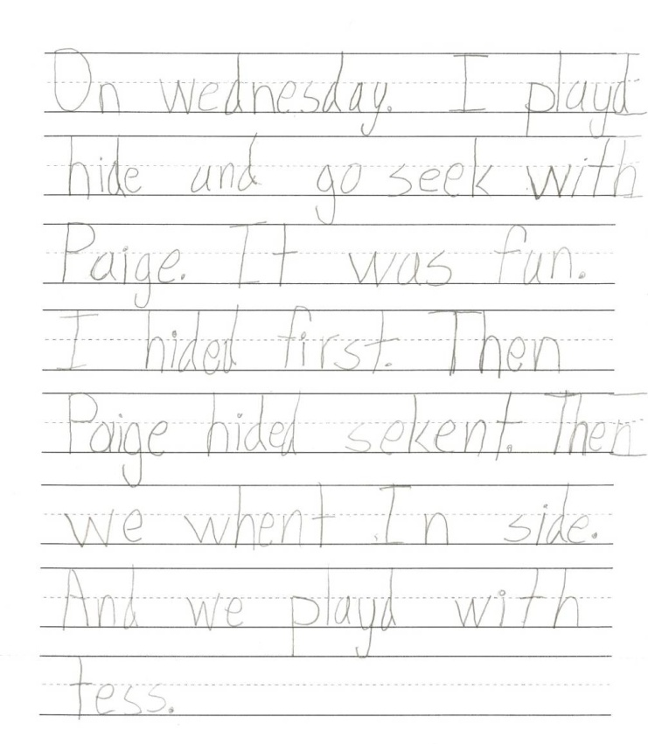
We practice writing in all subjects. Problem solving, reflecting on stories, recording observations, etc. As a result, your kindergartner will be writing in all subject areas by the end of kindergarten! (Developmentally appropriate writing)
End of the year writing should show:
Phonetic spelling with at least approximate beginning and ending sounds.
Many high frequency words used and spelled correctly.
Clear organization—stories should have a beginning, middle and end.
However, phonetic spelling is still perfectly acceptable—
especially with more complex or irregular spelling patterns.

Slide 10
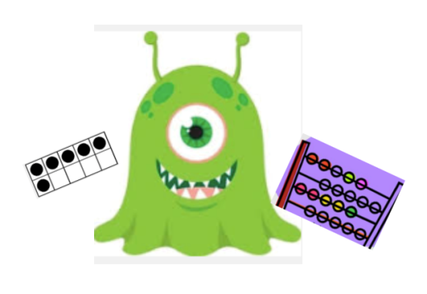
We will take a problem solving approach to math this year. Children will be encouraged to work together to find their own solutions to problems and then share out their strategies.
Problem solving…
Is a task for which the solution is not explicit.
Challenges students to discover and explore their own strategies to arrive at a solution.
Includes a reflection and communication of their thinking and reasoning.
Includes real world situations in a variety of ways.
When children solve problems in ways that make sense to them, they acquire new knowledge and make new connections with what they already know ! Our goal by the end of the year is for students to have shown at least 2-3 different ways to solve a problem, and write a sentence explaining their thinking!

Slide 11
Special Schedules
Library Our library time is Friday 1:15-1:45. Books will be due Friday morning at the latest. Students check out 1 book a time and only if they have returned previous book. | Specials We will follow a Red Week/Gold Week Schedule 1st week=red week Red Week: PE & Art Gold Week: PE & Music

Slide 12
Assemblies
Grade Level as well as school wide assemblies will take place on
various dates throughout the year. As soon as that calendar of events is
made available to us, we will share
that information with you.

Slide 13
Communication
The absolute best way to get a hold of me is via email (Marjorie_Manning@roundrockisd.org) I check it often and will try to respond as soon as possible. Sometimes I may read an email and not have time to respond during the school day, so please be understanding if you do not get a response right away. I will do my best to respond after the kids have left for the day. You are welcome to call the school/ my classroom phone if there is something that you need communicated immediately and I have not responded to an email. Please reserve classroom calls for before or after school hours.
I will send home a daily folder with your student. This is where they will record their earned points (you will learn about this in a bit) and I will put any information that has to go home right away. This is also a great place to return forms to me, field trip money, etc. Please check your child’s folder each night and then have them place in their backpack to bring back to school the next morning.
We will send home our Thursday folder each week. This will contain important information from me, PTA, the office, etc. Please remove everything from the folder & return child’s Thursday folder to your teacher Friday. If there is something that needs to be returned, place it in the blue daily folder, but make sure that your child is aware of it and will bring it to me.
Starting in a few weeks, we will be posting newsletters to our kindergarten weebly page! This link is on the Patsy Sommer website:
https://sommer.roundrockisd.org/kindergarten/

Slide 14
Calling all Volunteers…
We LOVE volunteers and depend greatly on you to help make our school year
successful!! If you are willing and able to volunteer in the school, you will have to complete the volunteer information on the RRISD website.
https://roundrockisd.org/volunteer/
If you are unable to volunteer during the school
day, but still want to be involved, please email me!!
Can I lend a hand?
Some examples of ways you can help our class this year:
Thursday Folders *See sign up genius on our class website.
Room Parents
Reading to the Class
At Home Helpers
Special Projects/Events
Field Trips
Watch D.O.G.S

Slide 15
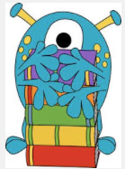
Things you should practice
with your child at home… 1. Tying his/her shoes and dressing self. 2. Unzipping and zipping his/her backpack. 3. Opening snack packages independently. 4. Buttoning and unzipping his/her pants. 5. Cleaning up his/her toys in less than 5 minutes. 6. Complying with a request the first time asked. 7. Taking care of their own toileting needs. This includes changing clothes if necessary.
8. Anything that encourages independence & responsibility!!

Slide 16
Behavior
Behavior Plan
As you know, good behavior and learning go hand in hand. Simple class rules have been established to ensure your child experiences a positive and safe learning environment. Even as kindergarteners, children need to learn the importance of accepting responsibility for their actions. In our classroom, we keep track of behavior with the following system:
Students can earn class dojo points for desired behaviors (following directions quickly, raising a hand to speak, listening, manners, respecting themselves, others and the school, and making smart choices, etc.).
Students can lose a class dojo point if they are not following our class rules.
At the end of the day we review our daily points & record them on the log in our daily folder. Various rewards will be decided on as a class and can be earned by students displaying positive points.
Parent codes help you stay updated with points your student earned!
Please review the behavior chart with your student daily. It is important to discuss your student’s day with them, but know that each day is a fresh start!
Support from home is absolutely essential to make this behavior system work.

Slide 17
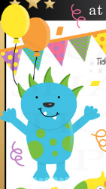
Celebrations!!
We know that this is an important time in a kid’s life &
we LOVE to celebrate birthdays!
With that being said, there are a few things to keep in mind:
-We will celebrate birthdays after lunch,
before our recess time.
-You may bring a small nut free treat (cookies, brownies or donuts) for
the class if you wish to celebrate birthdays at school.
-Please do not bring balloons as we have some with allergies.
-We will have two class parties this year
(Winter Party, Valentine’s Party &
then we will do an end of year celebration)

Slide 18
Next Generation Digital Classroom
I am SOOO excited to share this with you!
Our classroom is part of a pilot program for Round Rock ISD! This is the 3rd and final year of the program in which certain classrooms will receive a class set of tablets to utilize for instruction.
We are lucky enough to be paired with a 1st grade classroom (Mrs. Ashby) for this program. Our classes will be collaborating on projects throughout the year using tablets to help support our learning!
These tablets will remain at school and will be used to help support learning in our classrooms! This will be done in a very safe way so as to protect the privacy of each of our learners while still giving them the chance to experience this wonderful technology!
We will use our technology in meaningful ways to help bring the real world to our fingertips! I cannot wait to share all of the wonderful things that your student will do using these tools! For more information throughout the year, please visit our class website!

Slide 19
TAG/Enrichment
We have monthly “enrichment
lessons” with our TAG teacher.
If you have questions about TAG,
I suggest emailing Angel
Ruppert-Straton (she is our contact
for TAG)
angela_ruppert-stratton@roundrockisd.org

Slide 20
Donations
-There are certain items that our class could use to help support our learning.
-From time to time I may email or send out a sign up genius if we have a specific project coming up that will need supplies.
-Feel free to view the class wish list on the easel and take the hand with any item you wish to donate. This can also be found on our class website.
This is optional, but greatly appreciated!

Slide 21
Field Trips!!!
-We will take two field trips this year.
One in the fall (very soon!) and one
in spring.
-We will send home permission slips and
collect money for admissions at a later date.
-We will also be ordering class shirts for field
trips, so please look for that information
coming home soon! It is not required but is
strongly encouraged.

Slide 22
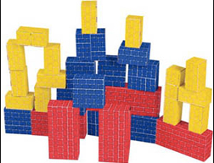
Choice Workshop
Simply put, this time during our school day is devoted to help your child learn
through purposeful play and inquiry. In Kindergarten, we concentrate on the whole child and it is important to help your child develop the following:
Social/Emotional growth
Great communication/problem solving skills
Learn how to build meaningful relationships
Build character traits
Model leadership skills

